Slide 1
DEPARTMENT OF MATHEMATICS
SGGSJ GOVERNMENT COLLEGE
PAONTA SAHIB

Slide 2
COURSE NAME : VECTOR CALCULUS
COURSE CODE : 310TH

Slide 3
CONTENTS
Divergence of a vector point function.
Solenoidal vector.
Problem based on divergence of a function.

Slide 4
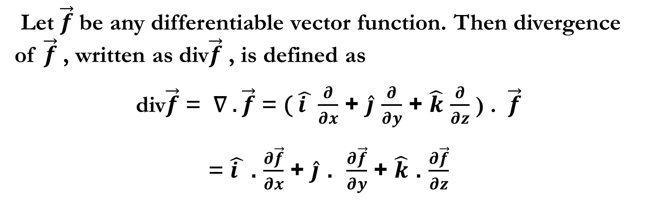
DIVERGENCE OF A VECTOR POINT FUNCTION :
Let $\vec{f}$ be any differentiable vector function. Then divergence of $\vec{f}$ , written as div$\vec{f}$ , is defined as
div$\vec{f}$ = ∇ . $\vec{f}$ = ( $\hat{i }$ $\frac{∂}{∂x}$ + $\hat{j}$ $\frac{∂}{∂y}$ + $\hat{k}$ $\frac{∂}{∂z}$ ) . $\vec{f}$
= $\hat{i }$ . $\frac{∂\vec{f}}{∂x}$ + $\hat{j}$ . $\frac{∂\vec{f}}{∂y}$ + $\hat{k}$ . $\frac{∂\vec{f}}{∂z}$

Slide 5
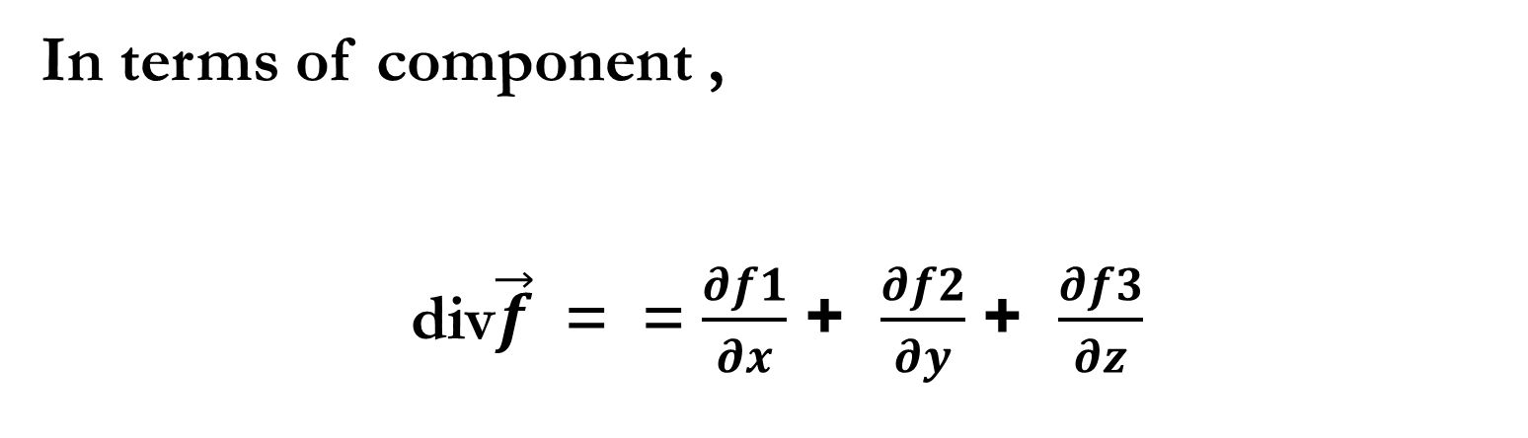

NOTE : Divergence is always a vector point function and ∇ . $\vec{f}$ is a scaler point function.
In terms of component ,
div$\vec{f}$ = = $\frac{∂f1}{∂x}$ + $\frac{∂f2}{∂y}$ + $\frac{∂f3}{∂z}$

Slide 6
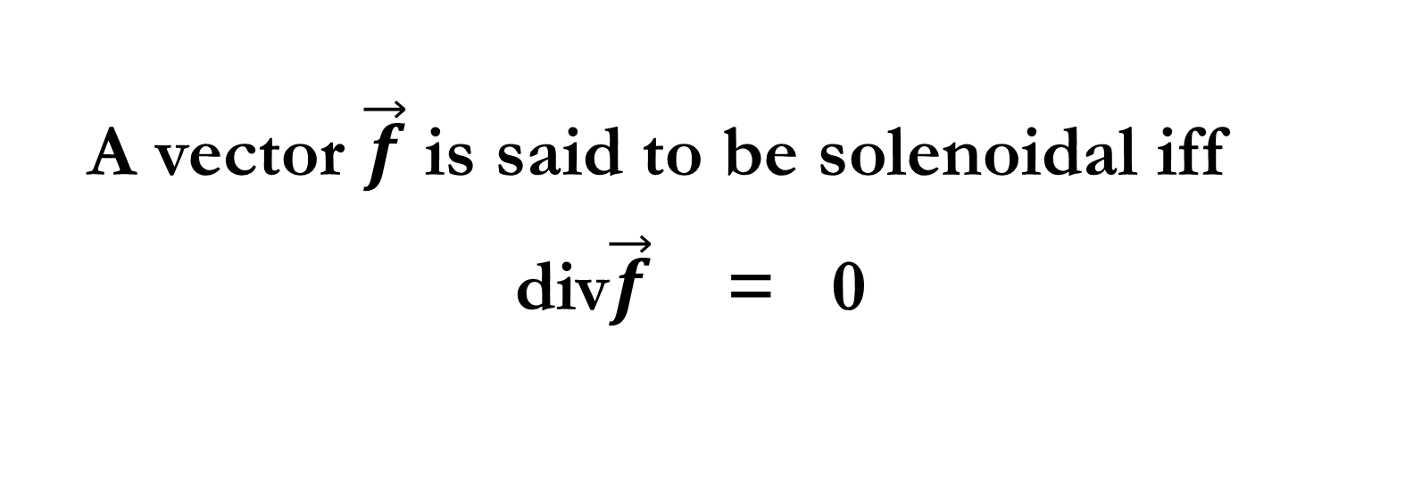
Solenoidal vector
A vector $\vec{f}$ is said to be solenoidal iff
div$\vec{f}$ = 0

Slide 7
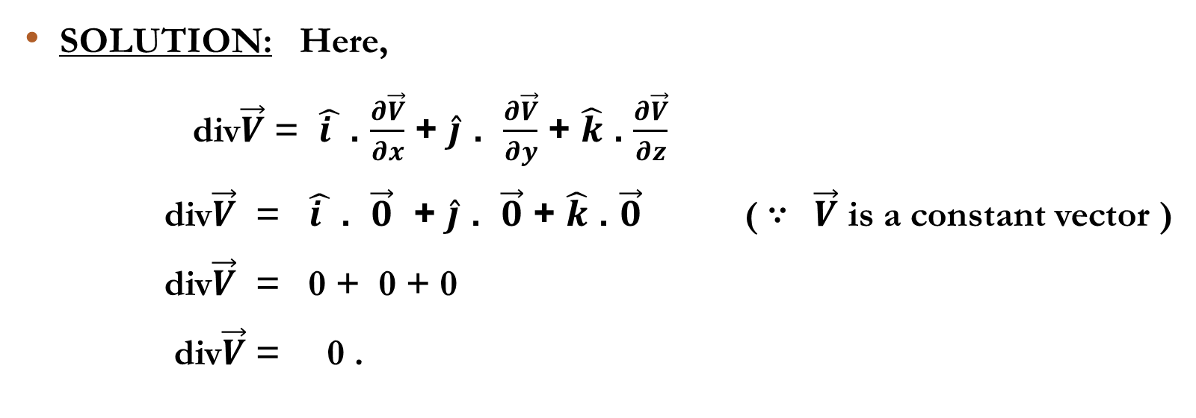

PROBLEM 1 : If $\vec{V}$ is a constant vector , then div$\vec{V}$ = 0.
SOLUTION: Here,
div$\vec{V}$ = $\hat{i }$ . $\frac{∂\vec{V}}{∂x}$ + $\hat{j}$ . $\frac{∂\vec{V}}{∂y}$ + $\hat{k}$ . $\frac{∂\vec{V}}{∂z}$
div$\vec{V}$ = $\hat{i }$ . $\vec{0}$ + $\hat{j}$ . $\vec{0}$ + $\hat{k}$ . $\vec{0}$ ( ∵ $\vec{V}$ is a constant vector )
div$\vec{V}$ = 0 + 0 + 0
div$\vec{V}$ = 0 .

Slide 8
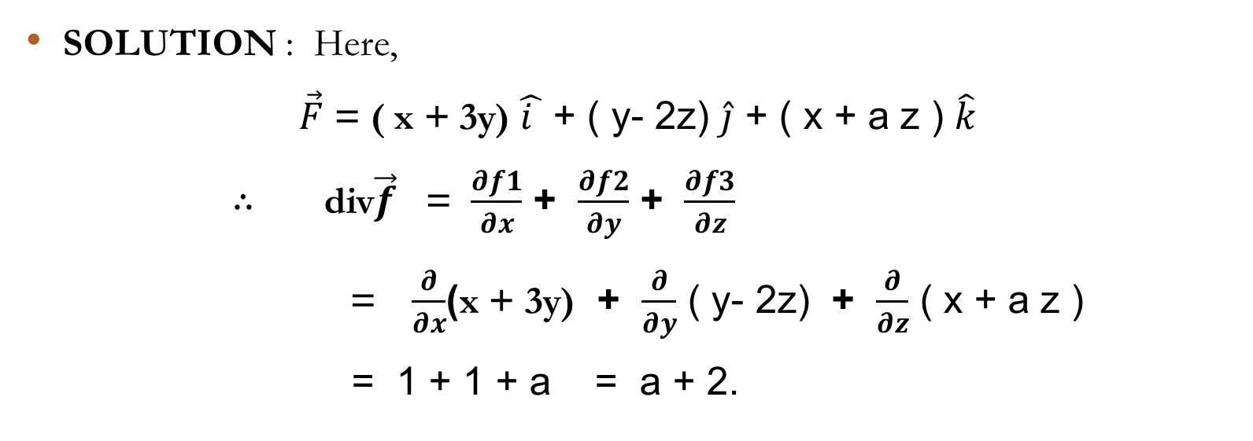
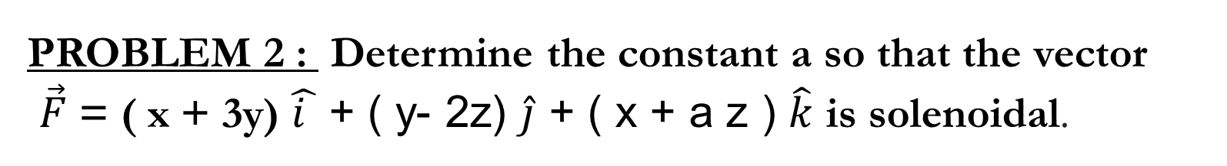
PROBLEM 2 : Determine the constant a so that the vector
$\vec{F}$ = ( x + 3y) $\hat{i }$ + ( y- 2z) $\hat{j}$ + ( x + a z ) $\hat{k}$ is solenoidal.
SOLUTION : Here,
$\vec{F}$ = ( x + 3y) $\hat{i }$ + ( y- 2z) $\hat{j}$ + ( x + a z ) $\hat{k}$
∴ div$\vec{f}$ = $\frac{∂f1}{∂x}$ + $\frac{∂f2}{∂y}$ + $\frac{∂f3}{∂z}$
= $\frac{∂}{∂x}$(x + 3y) + $\frac{∂}{∂y}$ ( y- 2z) + $\frac{∂}{∂z}$ ( x + a z )
= 1 + 1 + a = a + 2.

Slide 9
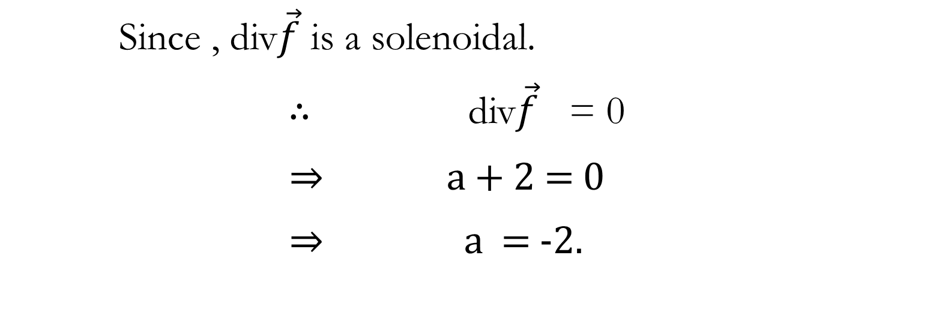
SOLUTION CONTINUE…
Since , div$\vec{f}$ is a solenoidal.
∴ div$\vec{f}$ = 0
⇒ a + 2 = 0
⇒ a = -2.

Slide 10
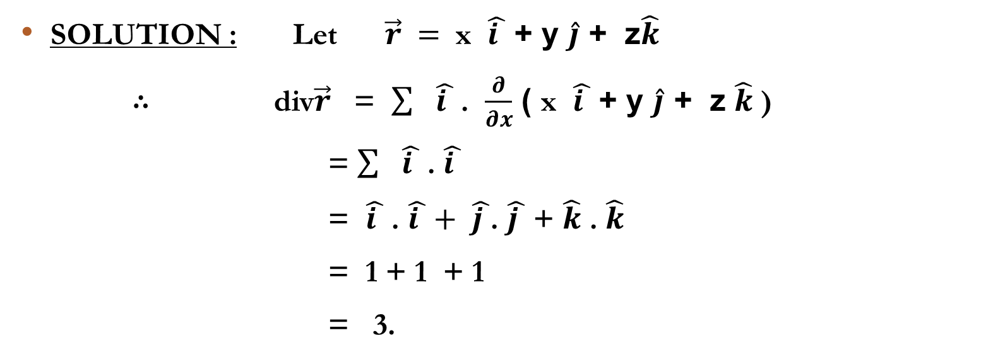

PROBLEM 3 : Prove that div $\vec{r}$ = 3.
SOLUTION : Let $\vec{r} =$ x $\hat{i }$ + y $\hat{j}$ + z$\hat{k}$
∴ div$\vec{r}$ = $\sum{ \hat{i }}$ . $\frac{∂}{∂x}$ ( x $\hat{i }$ + y $\hat{j}$ + z $\hat{k}$ )
= $\sum{ \hat{i }}$ . $\hat{i }$
= $\hat{i }$ . $\hat{i }+$ $\hat{j }$. $\hat{j }$ + $\hat{k}$ . $\hat{k}$
= 1 + 1 + 1
= 3.

Slide 11
THANKYOU

